Slide 1
CSC 3511 Security and Networking
Week 5, Lecture 1: Network Layer and IP Protocol

Slide 2
Roadmap
Network Layer: Overview
Routers
IP: Internet Protocol
IP Address and DHCP
Network Address Translation (NAT)

Slide 3

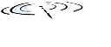













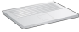
Network-layer Services and Protocols
Layer 3 (Network/IP) gave us the ability to transport segment from sending to receiving host
Sender: encapsulates segments into datagrams, passes to link layer
Receiver: delivers segments to transport layer
Network layer protocols in every Internet device: hosts, routers
Internet “best effort” service model; No guarantees on:
Successful datagram delivery to destination
Timing or order of delivery
Bandwidth available to end-end flow
mobile network
national or global ISP
application
transport
network
link
physical
network
link
physical
network
link
physical
network
link
physical
network
link
physical
network
link
physical
datacenter
network
application
transport
network
link
physical
The Internet Protocol (IP) is the dominant network layer protocol that provides this host-to-host delivery service
enterprise
network

Slide 4
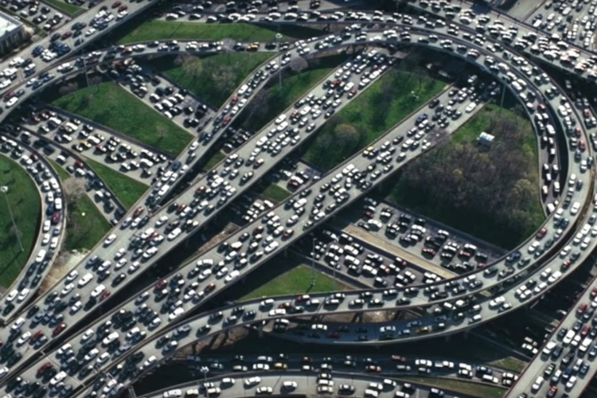
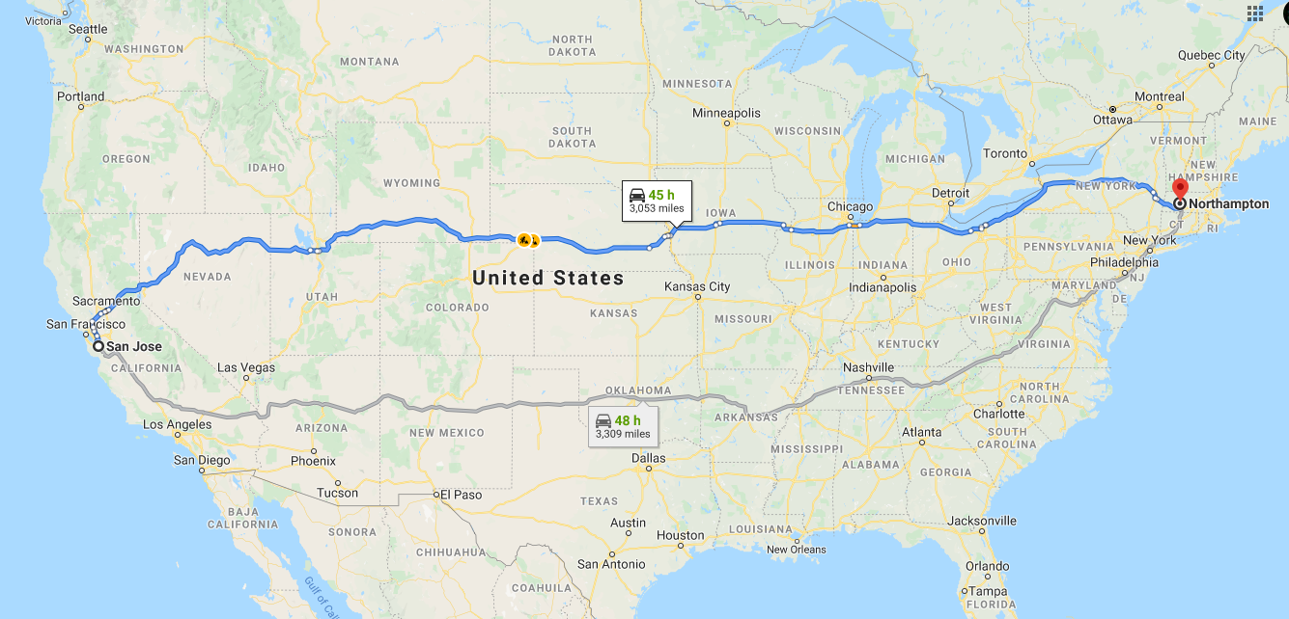
Two Key Network Layer Functions
Network layer functions:
Forwarding: move packets from a router’s input link to appropriate router output link
Routing: determine route taken by packets from source to destination
Analogy: taking a trip
Forwarding: process of getting through single interchange
Routing: process of planning trip from source to destination
Core component: routers
Examines header fields in all IP datagrams passing through it
Moves datagrams from input ports to output ports to transfer datagrams along end-end path
Forwarding
routing
IP provides both functions: IP forwarding (data plane) + IP routing (control plane)

Slide 5

Network Layer: Data Plane and Control Plane
Data plane:
Local, per-router function
Determines how datagram arriving on router input port is forwarded to router output port
Control plane
Network-wide logic
Determines how datagram is routed among routers along end-end path from source host to destination host
Routing
Algorithm
control
plane
data
plane
values in arriving
packet header
0111
1
3
2

Slide 6
The Internet Protocol (IP)
What IP does (functions):
Addressing: Assigns logical IP address
Encapsulation: Wraps transport layer segments in IP datagrams
Forwarding: Moves packets hop-by-hop toward destination
Fragmentation: Breaks/reassembles packets for different link MTUs
What IP Contains/Related Protocols:
IPv4 / IPv6 addressing and packet format
Address Configuration: DHCP (automatic IP assignment)
Address Translation: NAT (private ↔ public addresses)
Support Protocols: ICMP (error reporting), ARP (address resolution)
Routing
Algorithm
Control plane: Separate routing algorithms (RIP, OSPF, BGP, etc.) populate IP forwarding tables
control
plane
data
plane
Data plane: Internet Protocol performs forwarding based on destination IP address
0111
1
3
2
Notes:
MTU: Maximum Transmission Unit. 1500 Bytes for Ethernet

Slide 7
Roadmap
Network Layer: Overview
Routers
IP: Internet Protocol
IP Address and DHCP
Network Address Translation (NAT)

Slide 8
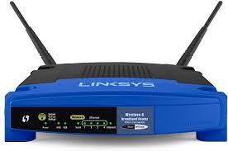
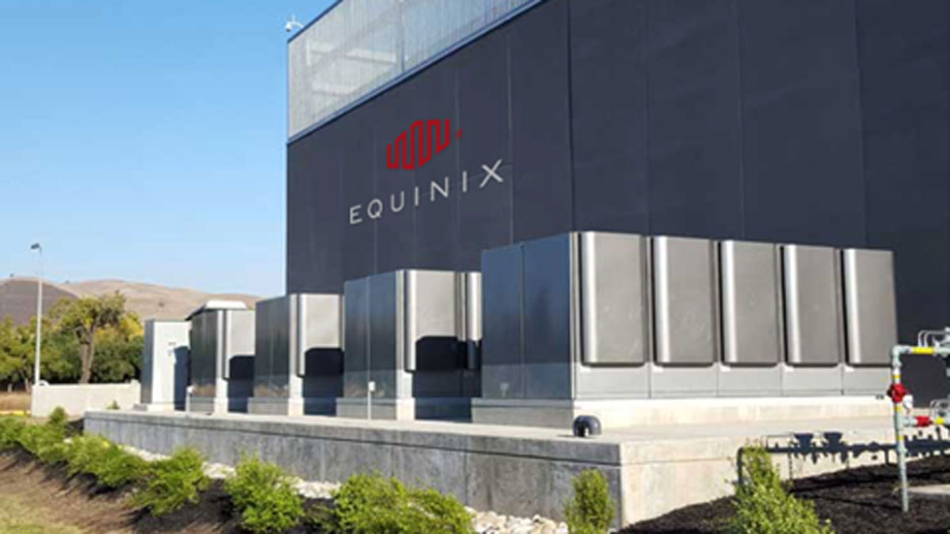
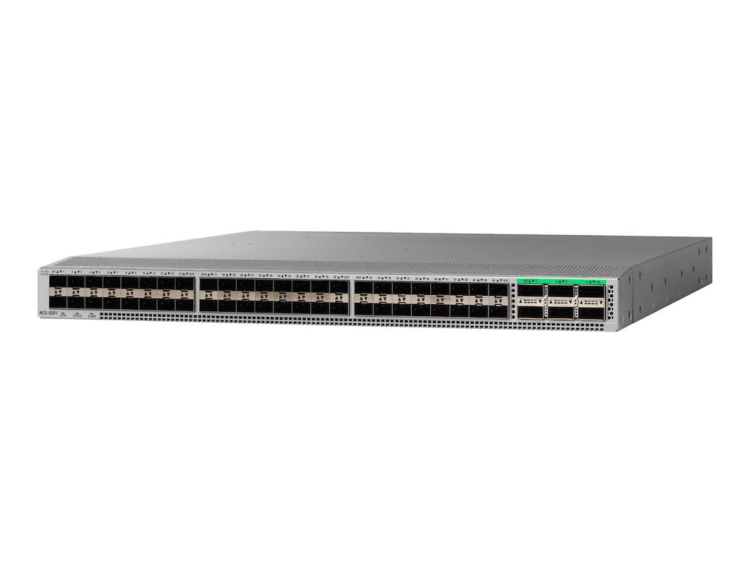
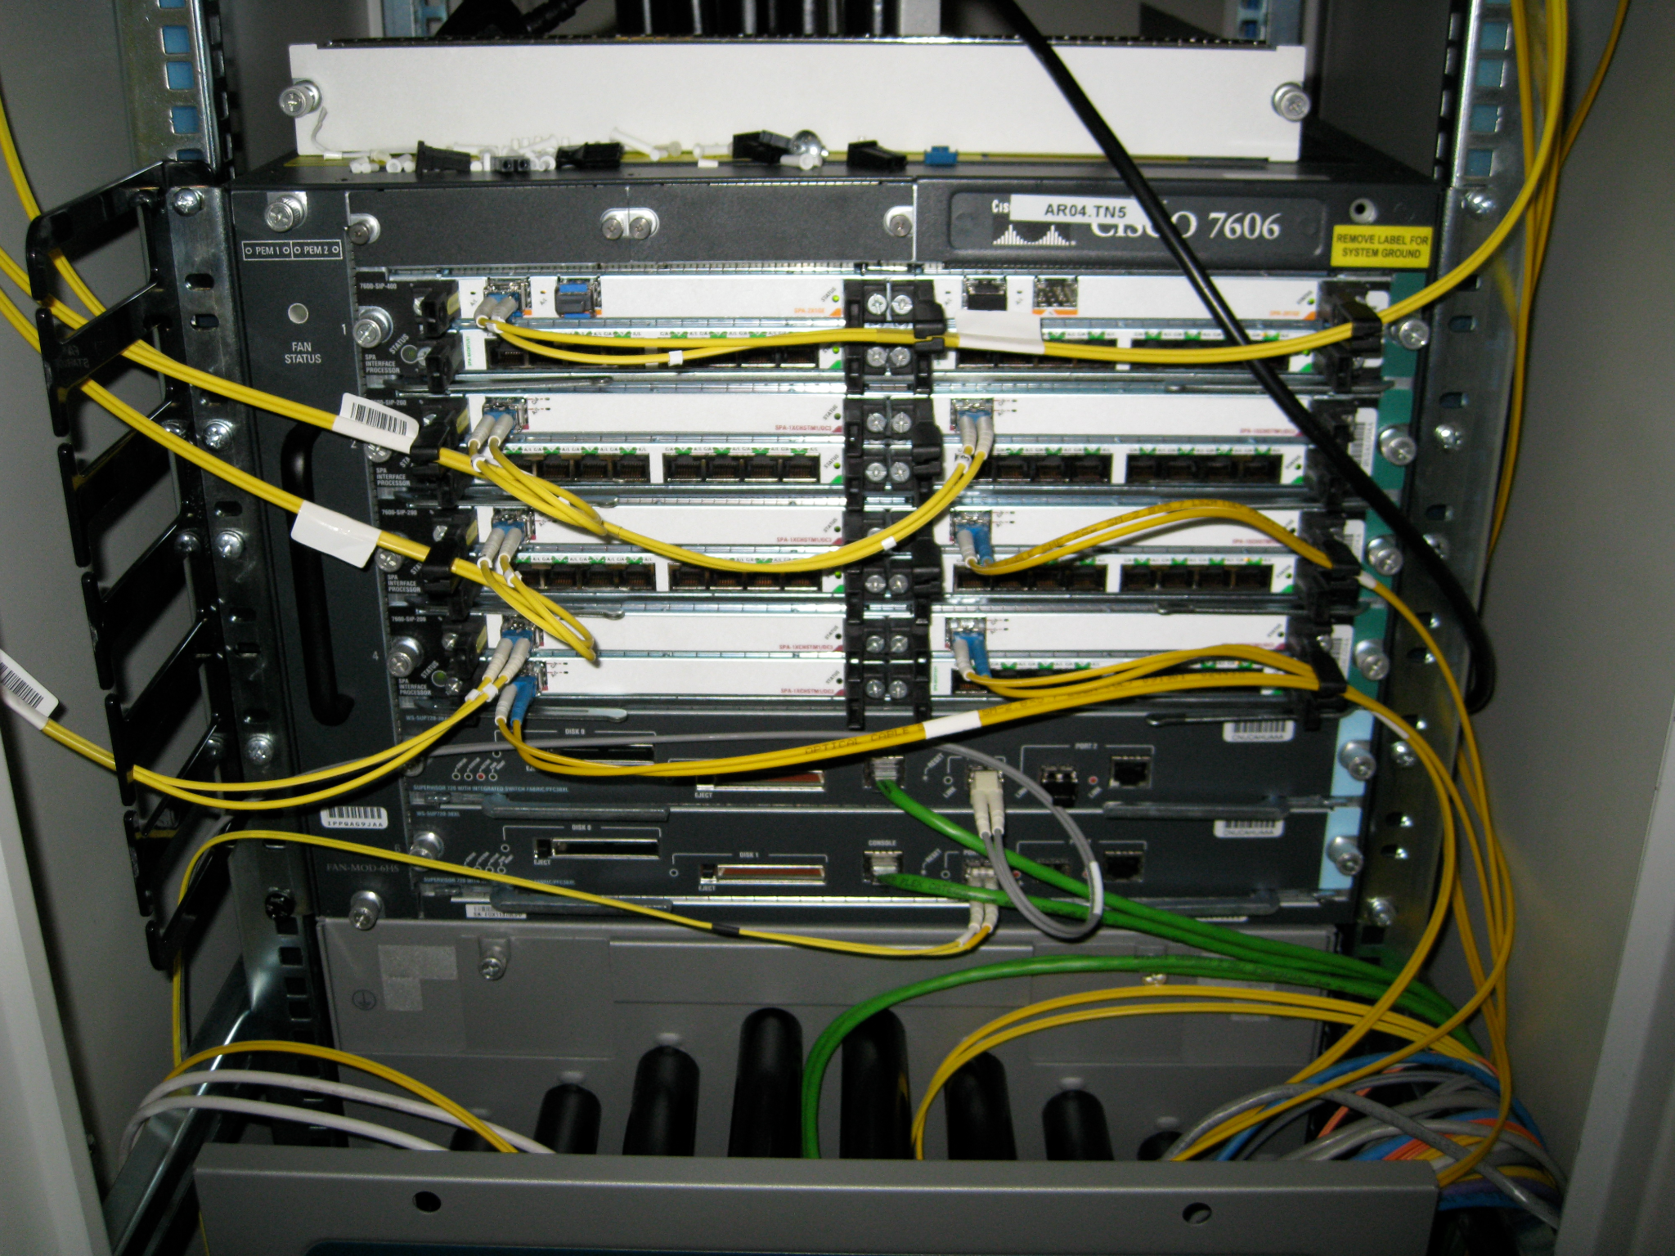
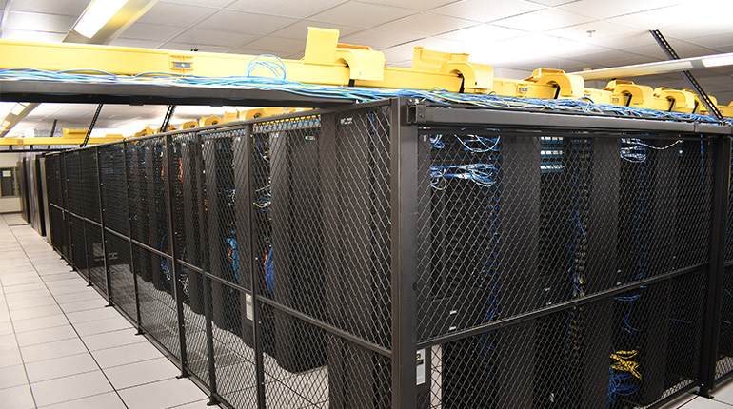
Routers
A router performs routing protocols to learn about routes
A router receives packets and forwards them according to the forwarding table
What do routers look like in real life?
A router is just a computer specialized for forwarding packets
Colocation facility (aka carrier hotel): A building where multiple ISPs install routers

Slide 9
Router Planes
The components of a router can be split into 3 planes:
The data plane handles forwarding packets
Used every time a packet arrives: Nanosecond time scale
Operates locally; No coordinating with other routers
The control plane performs routing protocols
Used every time the network topology changes; Second time scale
The management plane lets the operator interact with the router.
Operator uses network management system (NMS) to interact with router
Tell the router what to do, and monitor what the router is doing
Example: Assigning costs to links
Example: How much traffic is being sent on each link?
Each plane is optimized for its tasks and its time scale

Slide 10
What‘s Inside a Router: View of Components
A router is just a computer specialized for forwarding packets
Chassis
Chassis: The metal box holding the hardware
Controller Card
Control processor: Runs routing protocols and puts forwarding tables on linecards
Also handles management plane
CPU
Linecard
Removable linecards gives us flexibility in scaling the router
1–20 linecards per chassis
CPU
Linecard
CPU
Each linecard has several ports A port can be used for both input/output
Linecard
Each linecard has some hardware to control its functionality
CPU

Slide 11


What‘s Inside a Router: View of Port
Linecard
CPU
lookup,
forwarding
queueing
line
termination
link
layer
protocol
(receive)
switch
fabric
Physical layer:
bit-level reception
Datagram
Link layer:
e.g., Ethernet
Decentralized switching:
Input port queuing: if datagrams arrive faster than forwarding rate into switch fabric
Using header field values, lookup output port using forwarding table in input port memory (“match plus action”)
Frame
Notes:
Green box: a physical layer responsible for receiving bit level transmission. Copper, fiber wireless.
Link layer in blue: bit assemble into Ethernet frame.
But most critical one: forwarding table/function.
Lookup and forward is “Match plus action” behavior.
Buffer could be full, and packet will be lost

Slide 12
What's Inside a Router: View of Links
Controller card, aka network interface controller (NIC), connects to linecards, provides physical connection to a network, and manages routing operations
Linecard
Chassis
Controller Card
Linecard
Fabric
Linecard
Linecard
Linecard
Linecard
Linecard
Each linecard is connected to the fabric: A bunch of wires providing high-bandwidth interconnection between linecards
Controller Card

Slide 13
What's Inside a Router: View of a Linecard
Linecard
CPU
Forwarding Chip
Forwarding Chip
Specialized hardware optimized to forward packets
Fabric Chip(s)
Sends packets into the fabric, to other ports on the router
Fabric
To Fabric

Slide 14
What's Inside a Router: Data Plane
Data plane/Forwarding: Packet travels from port to port, via forwarding chips and fabric (chips)
Chassis
Controller Card
Control Processor (x86)
Linecard
Linecard
Fabric
Fabric
Forwarding Chip(s)
Fabric Chip(s)
Fabric
Fabric Chip(s)
Forwarding Chip(s)
Local CPU (x86)
Local CPU (x86)

Slide 15
What's Inside a Router: Data Plane
Control plane/Routing: Controller card talks with other routers, and programs linecards with routes
Chassis
Controller Card
Routing Protocol
Other Routers
Control Processor (x86)
Linecard
Linecard
Fabric
Fabric
Forwarding Chip(s)
Fabric Chip(s)
Fabric
Fabric Chip(s)
Forwarding Chip(s)
Local CPU (x86)
Local CPU (x86)

Slide 16
Roadmap
Network Layer: Overview
Routers
IP: Internet Protocol
IP Address and DHCP
Network Address Translation (NAT)

Slide 17
Hierarchical Network Addressing
Recall: The Internet is a network of networks
Leads naturally to a hierarchy of addresses
Each network gets a number; Then, each host gets a number inside the network
Hosts that are "close to each other" (in the same network) share part of their address
Analogy: All third-floor room numbers start with the digit 3
Network 1
Network 2
2.1
2.2
2.3
Network 3
1.2
1.1
2.4
3.1
3.2
2.5
Network 4
3.3
2.6
2.7
4.1
4.2
4.3
4.4
4.5
4.6
Notes:
Network layer overview (your current slides 1-3)
IP Introduction → "Network layer needs addressing..."
IP Addressing → "What are IP addresses, format, structure“
IP Packet Format → "How addresses are carried in headers"
Forwarding Basics → "How routers use destination IP to consult forwarding table"
Then dive deeper into forwarding tables, longest prefix matching, etc.

Slide 18

IP (v4) Addresses
An IP address is a 32-bit number that uniquely identifies a network interface. We could write an IP address as a 32-bit binary number:
11011100111010001001101001011101
What is an interface?
The physical connection point between a device and a network. E.g., Ethernet port, WiFi adapter, fiber connection, etc.
Each interface connects to one physical link and has one IP address
Routers have multiple interfaces → multiple IP addresses (one per connected network)
Hosts typically have 1-2 interfaces (e.g., Ethernet, WiFi)
223.1.1.1
223.1.2.1
223.1.1.2
223.1.1.4
223.1.2.9
223.1.1.3
223.1.3.27
223.1.2.2
223.1.3.1
223.1.3.2

Slide 19
IP (v4) Addresses
An IP address is a 32-bit number that uniquely identifies a network interface. We could write an IP address as a 32-bit binary number:
11011100111010001001101001011101 ➔ Nobody wants to read that
Dotted quad (dotted-decimal) notation:
Split into groups of 8 bits
Write each 8-bit number in decimal, separated by dots
Q1: How to represent a “network”? How do we know the hosts are “close to each other”
11011100 11101000 10011010 01011101
220
.
232
.
154
.
93

Slide 20
IP Addresses: Network and Host Portions
A1: IP addresses have hierarchical (two-part) structure
Network prefix (high-order bits): Identify the host belongs to which network
Host portion (low-order bits): Identify specific host/interface on that network
Why this matters:
Hosts with same network prefix are on the same subnet (local network)
They can communicate directly without going through a router
Routers use network prefix for forwarding decisions
Q2: How do we indicate where to split the network and host portions?
220
.
232
.
154
.
93
Network Prefix
Host Portion

Slide 21
IP (v4) Addresses
A2: Slash notation (CIDR notation) specifies the network prefix length:
CIDR: Classless Inter Domain Routing (pronounced “cider”), address format: a.b.c.d/x
Network prefix: Fixed bits identify the network. Write as dotted quad
Prefix length: After the slash (/), write how many bits are in the network prefix
subnet 223.1.1.0/24
Examples:
220.232.144.0/24 means first 24 bits = (sub)network, last 8 bits = hosts. Host range is 220.232.144.0 – 220.232.144.255 (256 addresses on this subnet)
192.168.1.0/29 means 29 bits are fixed. Host range is 192.168.1.0 – 192.168.1.7
0.0.0.0/0 means no bits are fixed. All addresses
223.1.1.1
subnet 223.1.2.0/24
223.1.2.1
223.1.1.2
223.1.1.4
223.1.2.9
223.1.1.3
223.1.3.27
11011100 11101000 10010001 ........
223.1.2.2
Set all unfixed bits to 0
11011100 11101000 10010001 00000000
subnet
223.1.3.0/24
220
.
232
.
145
.
0
/24
223.1.3.1
223.1.3.2
Notes:
What’s a subnet : device interfaces that can physically reach each other without passing through an intervening router

Slide 22
Subnets
223.1.1.2
subnet 223.1.1/24
Where are the subnets?
What are the /24 subnet addresses?
223.1.1.1
223.1.1.4
223.1.1.3
223.1.9.2
223.1.7.0
subnet 223.1.7/24
subnet 223.1.9/24
223.1.9.1
223.1.7.1
223.1.8.1
223.1.8.0
subnet 223.1.2/24
223.1.2.6
subnet 223.1.8/24
223.1.3.27
subnet 223.1.3/24
223.1.2.1
223.1.2.2
223.1.3.1
223.1.3.2

Slide 23
IP (v4) Addresses
Netmask notation is an older alternative way to specify the network prefix:
Set network prefix bits to 1, and host bits to 0. Write as dotted quad
Useful in code: To extract network ID, bitwise AND the address and netmask
E.g., 220.232.144.93 AND 255.255.255.0 = 220.232.144.0
Slash notation is more convenient for humans; Netmask still used in some configurations (e.g., older routers, subnet calculators)
11011100 11101000 1001.... ........
Set all unfixed bits to 0
11111111 11111111 11110000 00000000
255
.
255
.
240
.
0
Slash notation: 220.232.144.0/20
Netmask notation: 220.232.144.0 (netmask 255.255.240.0)

Slide 24
Roadmap
Network Layer: Overview
Routers
IP: Internet Protocol
IP Address and DHCP
Network Address Translation (NAT)

Slide 25
IP addresses: how to get one?
That’s actually two questions:
Q1: How does a host get IP address within its network (host part of address)?
A1:
Hard-coded by sysadmin in config file (e.g., /etc/rc.config in UNIX)
DHCP: Dynamic Host Configuration Protocol: dynamically get address from a network server
Q2: How does network get subnet part of IP address?
A2: Gets allocated portion of its provider ISP’s address space

Slide 26
DHCP: Dynamic Host Configuration Protocol
Goal: host dynamically obtains IP address from network server when the host “joins” network
Support for mobile users who join/leave network
Can renew its lease on address in use
Allows reuse of addresses (only hold address while connected/on)
Typically, DHCP server will be co-located in router, serving all subnets to which router is attached
DHCP server
223.1.1.1
223.1.2.1
223.1.2.5
223.1.1.2
223.1.1.4
223.1.2.9
DHCP overview:
Host broadcasts DHCP discover msg [optional]
DHCP server responds with DHCP offer msg [optional]
Host requests IP address: DHCP request msg
DHCP server sends address: DHCP ack msg
223.1.1.3
223.1.3.27
Arriving DHCP client needs
address in this network
223.1.2.2
223.1.3.1
223.1.3.2

Slide 27

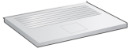
DHCP client-server scenario
DHCP server:
IP: 223.1.2.5,
port 67
Arriving client,
port 68
DHCP discover
src : 0.0.0.0, 68
dest.: 255.255.255.255,67
yiaddr: 0.0.0.0
transaction ID: 654
Broadcast: is there a DHCP server out there?
The two steps above can be skipped “if a client remembers and wishes to reuse a previously allocated network address” [RFC 2131]
DHCP offer
src: 223.1.2.5, 67
dest: 255.255.255.255, 68
yiaddr: 223.1.2.4
transaction ID: 654
lifetime: 3600 secs
Broadcast: I’m a DHCP server! Here’s an IP address you can use
DHCP request
DHCP can return more than just allocated IP address on subnet:
Name and IP address of DNS sever
Network mask (indicating network versus host portion of address)
Address of first-hop router for client
src: 0.0.0.0, 68
dest:: 255.255.255.255, 67
yiaddr: 223.1.2.4
transaction ID: 655
lifetime: 3600 secs
Broadcast: OK. I would like to use this IP address!
DHCP ACK
src: 223.1.2.5, 67
dest: 255.255.255.255, 68
yiaddr: 223.1.2.4
transaction ID: 655
lifetime: 3600 secs
Broadcast: OK. You’ve got that IP address!
Notes:
yiaddr: Your IP Address

Slide 28

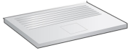
DHCP: Workflow
DHCP is an application layer protocol, running on top of UDP/IP
Connecting laptop will use DHCP to get IP address, address of first-hop router, address of DNS server
DHCP
DHCP
UDP
IP
Eth
Phy
DHCP
DHCP REQUEST message encapsulated in UDP, encapsulated in IP, encapsulated in Ethernet
DHCP
DHCP
DHCP
Ethernet frame broadcast (dest: FFFFFFFFFFFF) on LAN, received at router running DHCP server
DHCP
DHCP
UDP
IP
Eth
Phy
168.1.1.1
DHCP
DHCP
DHCP
DHCP
router with DHCP
server built into
router
Ethernet de-mux’ed to IP de-mux’ed, UDP de-mux’ed to DHCP

Slide 29
DHCP: Workflow
DHCP is an application layer protocol, running on top of UDP/IP
DCP server formulates DHCP ACK containing client’s IP address, IP address of first-hop router for client, name & IP address of DNS server
DHCP
DHCP
UDP
IP
Eth
Phy
DHCP
DHCP
DHCP
Encapsulated DHCP server reply forwarded to client, de-muxing up to DHCP at client
DHCP
DHCP
UDP
IP
Eth
Phy
Client now knows its IP address, name and IP address of DNS server, IP address of its first-hop router
DHCP
DHCP
DHCP
router with DHCP
server built into
router
DHCP

Slide 30
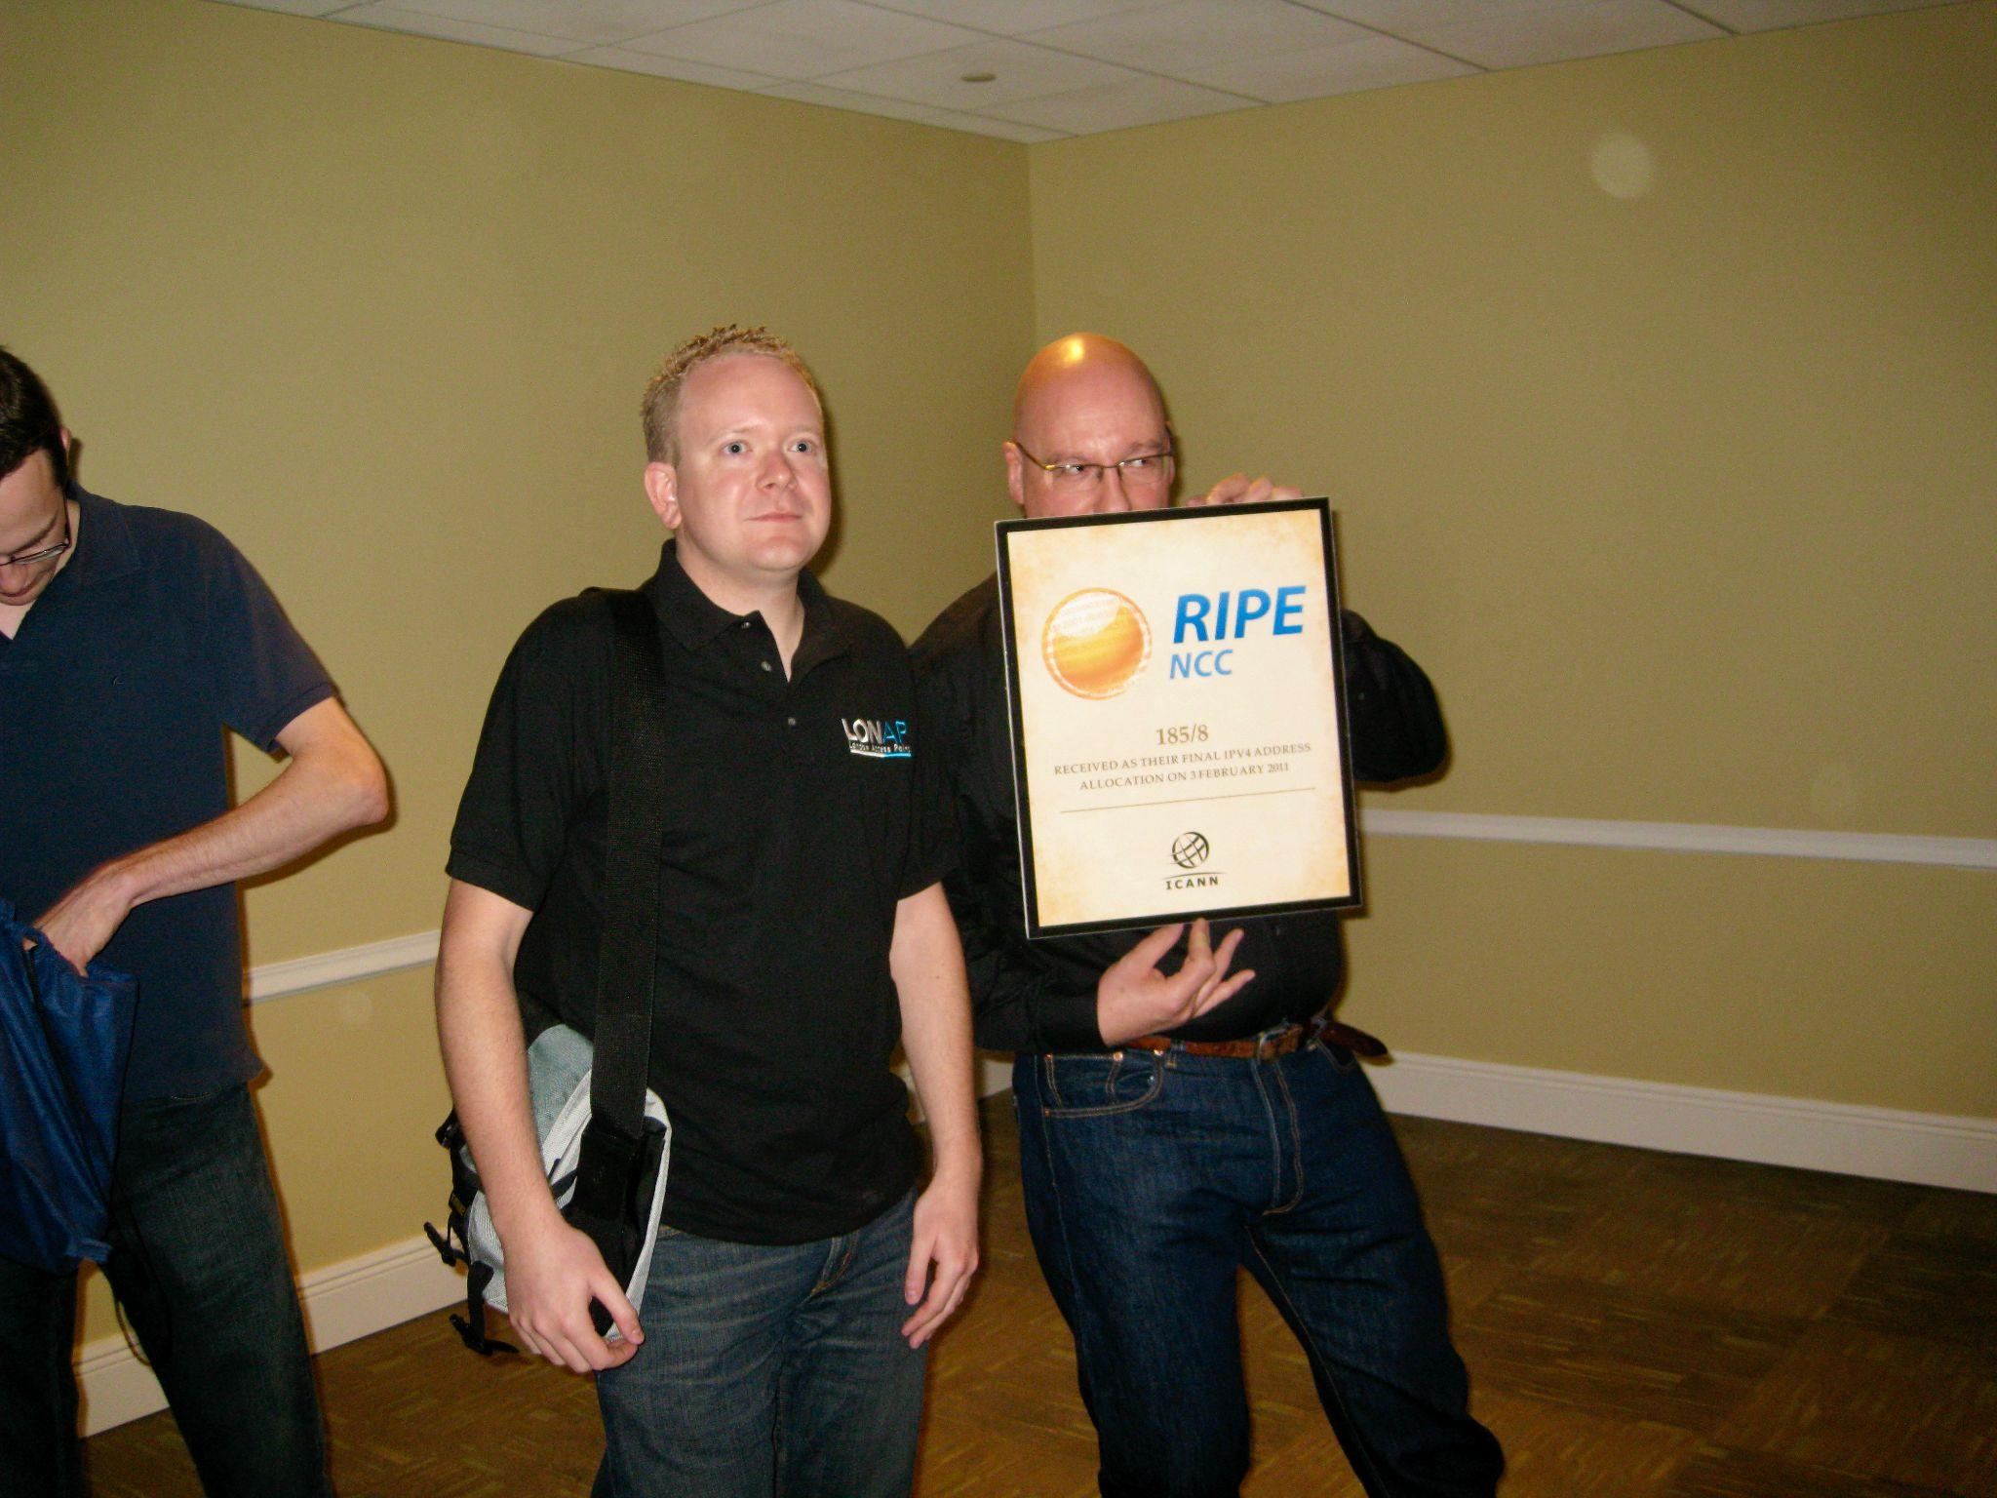
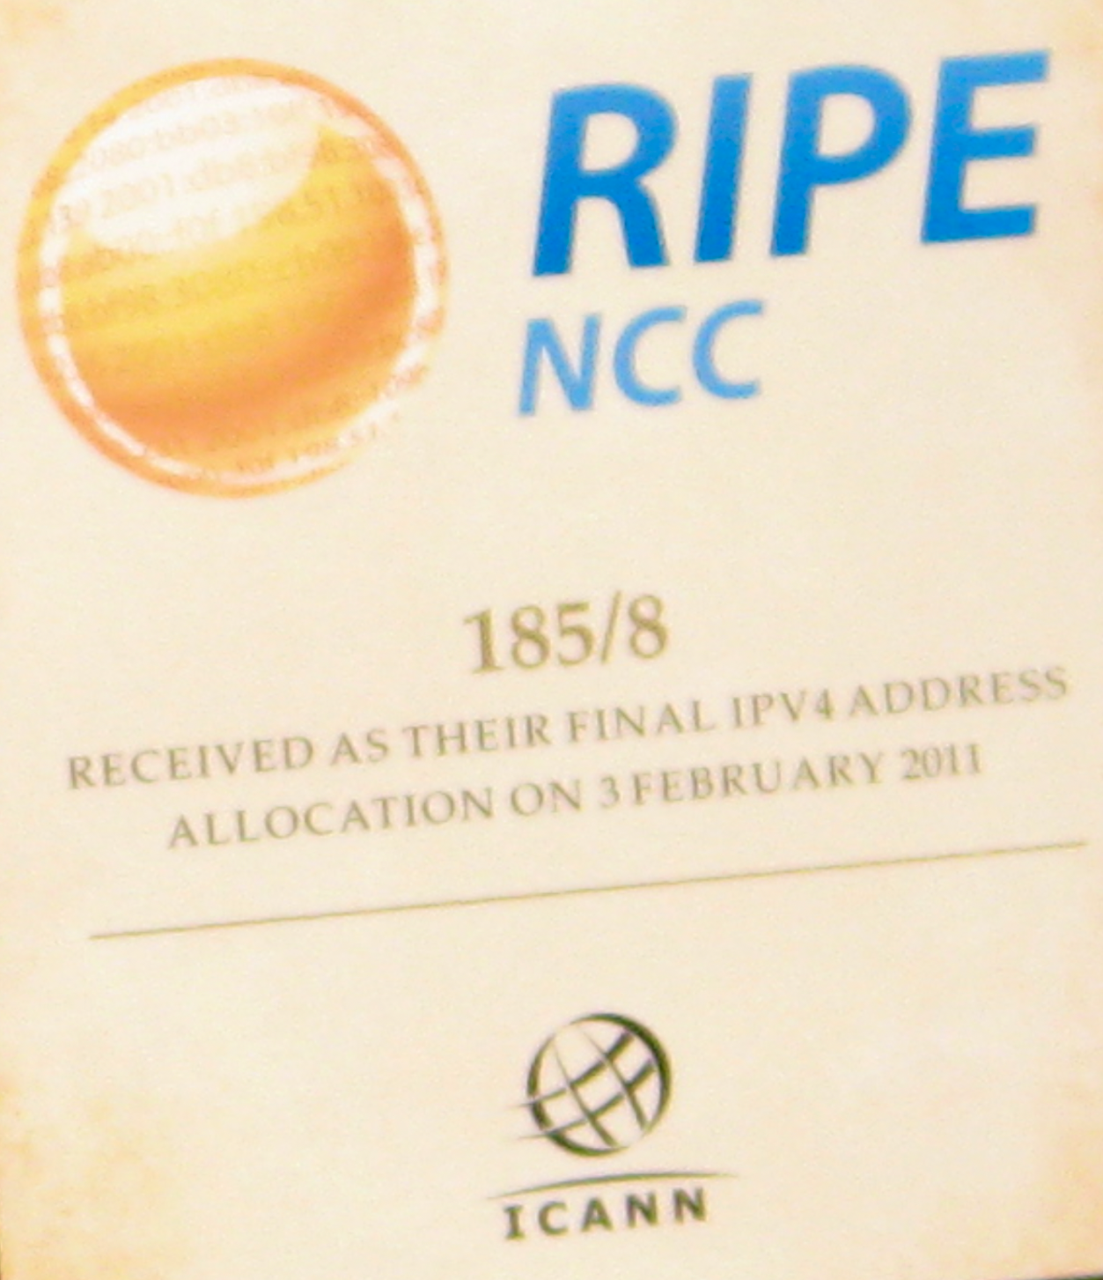
IP Addressing: Last Words ...
IPv4 addresses are 32 bits long. 2³² ≈ 4 billion addresses. Is that enough?
ICANN: Internet Corporation for Assigned Names and Numbers http://www.icann.org/
Allocates IP addresses, through 5 regional registries (RRs) (who may then allocate to local registries)
Manages DNS root zone, including delegation of individual TLD (.com, .edu , …) management
ICANN allocated last chunk of IPv4 addresses to regional registries in 2011

Slide 31
Introducing IPv6
IPv6 was introduced in 1998 to deal with IPv4 address exhaustion
Main difference: Addresses are now 128 bits, instead of 32
Fundamentally, same addressing structure as IPv4
Some other minor changes (won't discuss here)
Is 128 bits enough?
2¹²⁸ ≈ 3.4 × 10³⁸ possible addresses
We won't run out again, really?
IPv5 was an experimental protocol from the 1990s. It was never widely implemented

Slide 32
Introducing IPv6
IPv6 uses hexadecimal instead of decimal
2001:0DB8:CAFE:BEEF:DEAD:1234:5678:9012
Colon between every 4 hex digits (16 bits)
Shorthand:
Omit leading zeros per block: 2001:0DB8:0000:0000:0000:0000:0000:0001 → 2001:DB8:0:0:0:0:0:1
Omit a long string of zeros, once per address: 2001:DB8:0:0:0:0:0:1 → 2001:DB8::1
Can still use slash notation for ranges.
2001:0DB8::/32 has 32 bits fixed, and 296 addresses.
IPv5 was an experimental protocol from the 1990s. It was never widely implemented

Slide 33
Roadmap
Network Layer: Overview
Routers
IP: Internet Protocol
IP Address and DHCP
Network Address Translation (NAT)

Slide 34
NAT: Network Address Translation
Problem: IPv4 address is not enough for every host on the Internet.
IPv4 and IPv6 are not compatible with each other
Requires software and hardware upgrades, from both hosts and routers ➔ IPv6 adoption is slow (and ongoing)
Solution: Use private IP addresses to conserve IP addresses
Private ranges allocated for networks that don't require Internet access
Weird fact:
Your home network uses private IP addresses to conserve addresses
However, you do need Internet access!
rest of
Internet
local network (e.g., home network) 10.0.0/24
10.0.0.1
138.76.29.7
10.0.0.4
10.0.0.2
10.0.0.3

Slide 35
NAT: Network Address Translation
NAT (Network Address Translation): Use a single public IP address to represent many hosts in the local network.
Outgoing packets: Router changes private addresses to the public address.
Incoming packets: Router changes the public address back to private addresses.
rest of
Internet
local network (e.g., home network) 10.0.0/24
138.76.29.7
is the unique public addresses
10.0.0.1
138.76.29.7
10.0.0.4
10.0.0.1 – 10.0.0.4
are private addresses
10.0.0.2
10.0.0.3
All datagrams leaving local network have same source NAT IP address: 138.76.29.7, but different source port numbers
Datagrams with source or destination in this network have 10.0.0/24 address for source, destination (as usual)

Slide 36
NAT: Network Address Translation
Without NAT, if A sends a packet, replying to A is impossible
Because A's IP address is private
rest of
Internet
local network (e.g., home network) 10.0.0/24
From: S
To: A
From: A
To: S
10.0.0.1
Host A
S
138.76.29.7
10.0.0.4
10.0.0.2
Host B
T
Who the heck is A??
10.0.0.3
Host C

Slide 37
NAT: Network Address Translation
With NAT, if A sends an outgoing packet:
Router rewrites the header so it's coming from a public IP instead of a private IP
Router keeps a table, so it remembers where to send any replies
How to design this table?
rest of
Internet
local network (e.g., home network) 10.0.0/24
From: S
To: R?
From: A
To: S
10.0.0.1
Host A
S
138.76.29.7
10.0.0.4
10.0.0.2
Host B
T
R's NAT Table
Outside | Intside
10.0.0.3
Host C

Slide 38
NAT: Network Address Translation
NAT translation table
WAN side addr LAN side addr
2: NAT router changes datagram source address from 10.0.0.1, 3345 to 138.76.29.7, 5001,
updates table
1: host 10.0.0.1 sends datagram to 128.119.40.186, 80
138.76.29.7, 5001 10.0.0.1, 3345
…… ……
S: 10.0.0.1, 3345
D: 128.119.40.186, 80
Advantages:
Can change addresses of host in local network without notifying outside world
Security: devices inside local net not directly addressable, visible by outside world
10.0.0.1
1
2
S: 138.76.29.7, 5001
D: 128.119.40.186, 80
10.0.0.4
10.0.0.2
138.76.29.7
S: 128.119.40.186, 80
D: 10.0.0.1, 3345
4
S: 128.119.40.186, 80
D: 138.76.29.7, 5001
3
10.0.0.3
3: reply arrives, destination address: 138.76.29.7, 5001

Slide 39
NAT: Network Address Translation
Implementation: NAT router must (transparently):
Outgoing datagrams: replace (source IP address, port #) of every outgoing datagram to (NAT IP address, new port #)
Remote clients/servers will respond using (NAT IP address, new port #) as destination address
Remember (in NAT translation table) every (source IP address, port #) to (NAT IP address, new port #) translation pair
Incoming datagrams: replace (NAT IP address, new port #) in destination fields of every incoming datagram with corresponding (source IP address, port #) stored in NAT table

